Slide 1

Topic : A smart walking stick for the blind
Incharge guide: Ms.P.Raja Rajeswari Chandni

Slide 2
Team name : Medi Engineer
Team members
Imran Khan - 20112024
Madhan Rajan - 20112022
Kishore AB - 20112019
Ariharasudhan - 20112007
Stevegladwin - 20112046

Slide 3
ABSTRACT
With the rapid increase in the domain of 10T (Internet of Things) day by day, whereas people acquire intelligence very quickly but at the same time people doesn't have time to help others and even helping others is thought to be a hectic task.
In such a world where we don't have time for others, the people with disability are suffering the most.
As usual blind people used trained dogs and simple white stick for their navigation, but this method is not efficient to break the blindness barrier and also not so efficient to make blind people feel comfortable and live their life normally as normal people live.
.

Slide 4
I. INTRODUCTION
According to the World Health Organization survey held on 11th oct 2018 globally approximately 1.3 billion people live with some visual problem and approximately 36 million people are totally blind.
There are some existing methods available that offer help to the blind people in their navigation but that methods have some disadvantages.
This paper analysed the existing solutions and proposes an entire new approach to solve such problems.
Proposed approach not only overcomes the disadvantages of the existing approaches, but it is also reliable, cost efficient and easier for the blind people to use

Slide 5
What is ultrasonic blind walking stick?
Blind stick is an innovative stick designed for visually disabled people for improved navigation. We here propose an advanced blind stick that allows visually challenged people to navigate with ease using advanced technology. The blind stick is integrated with ultrasonic sensor along with light and water sensing.

Slide 6
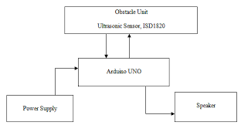
Block Diagram

Slide 7
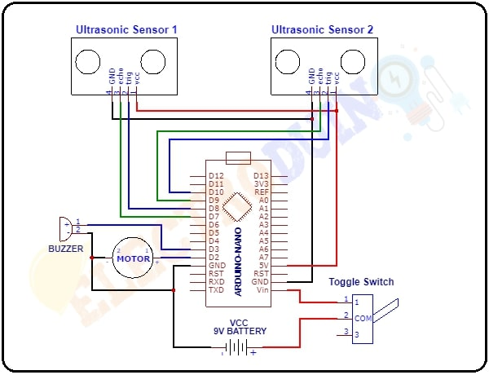
Circuit Diagram

Slide 8
S.No |  | Component Required |  | Quantity |  | Cost
1 |  | Arduino UNO |  | 1 |  | 390
2 |  | Arduino UNO Cable |  | 1 |  | 170
3 |  | Ultrasonic Sensor |  | 1 |  | 175
4 |  | Buzzer |  | 1 |  | 100
5 |  | Jumper Wire |  | 40 |  | 350
6 |  | Breadboard |  | 1 |  | 500
7 |  | 5V DC Adaptor For Arduino |  | 1 |  | 130
 |  |  |  |  | Total | 1850

Slide 9
Method
Take Arduino Nano, Buzzer, Ultrasonic sensor, Vibrating motor, battery, switch, and a wooden stick or plastic pipe.
Take stick and place ultrasonic sensor on it. Connect the Jumper wires on it.
Then place Buzzer and Vibrating motor on the stick.
Connect the jumper wires to buzzer and Vibrating motor.
Do connections from circuit diagram.
Place the Arduino Nano, Battery and switch on the stick.
Upload the code.
After Uploading now check for the Blind stick.

Slide 10
Advantage
Using this blind stick, a person can walk more confidently.
This stick detects the object in front of the person and give response to the user either by vibrating or through command. So, the person can walk without any fear.
This device will be best solution to overcome their difficulties.

Slide 11
Disadvantages
Smart stick Smart stick detects obstacles in front of the blind.
These solutions still have many disadvantages for example; They cant detect obstructions that are hidden but very dangerous for the blind such as downward stairs, holes etc.
Usually, the feedback information comes out as either vibration or sound signals.

Slide 12
CONCLUSION
This research work concludes that navigation of blind person using YOLO algorithm with object detectable sensors become more efficient than the existing methods.
GPS tracking is also one other feature in smart stick and cost of the stick is also considered keeping in mind of various blind person.
Future work is to make detection of obstacle more efficient and fast.

Slide 13
REFERENCES : https://techatronic.com/smart-blind-stick-using-arduino-and-ultrasonic-sensor/

